Slide 1

Housing Prices on Various Factors
By: Jun Sik Kim

Slide 2
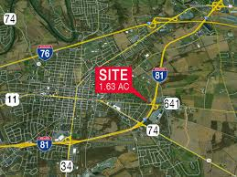
I81 along Carlisle

Slide 3


Tractable Data

Slide 4

Data Retrieval
Malaysian Condominium Prices Data
Kaggle
28 columns 4000 rows
Notes:
Ex of non useful columns :
Development firm
Land title
Tenure type
Developer

Slide 5
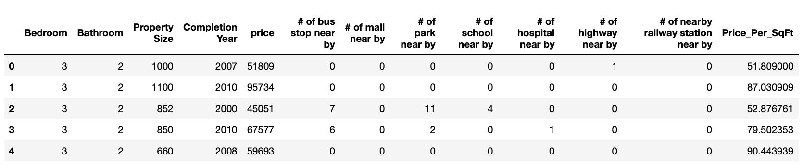
Exploratory Data Analysis
Notes:
Carlisle price per sqft 168
Manhattan price per sqft 1500-1900

Slide 6
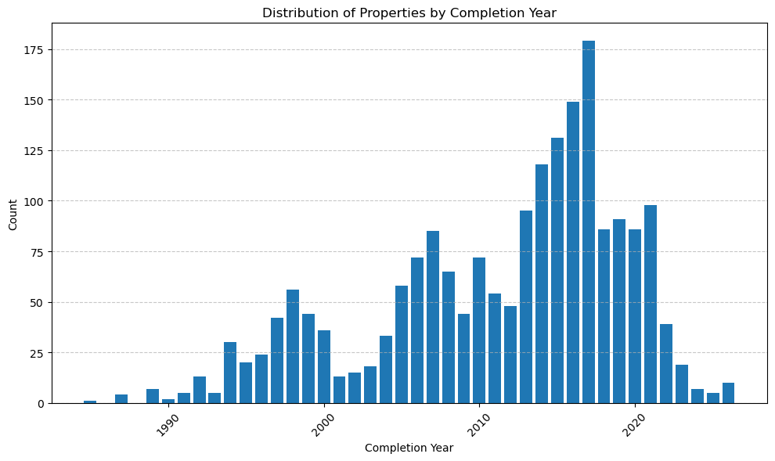
Exploratory Data Analysis
Condo by completion year

Slide 7
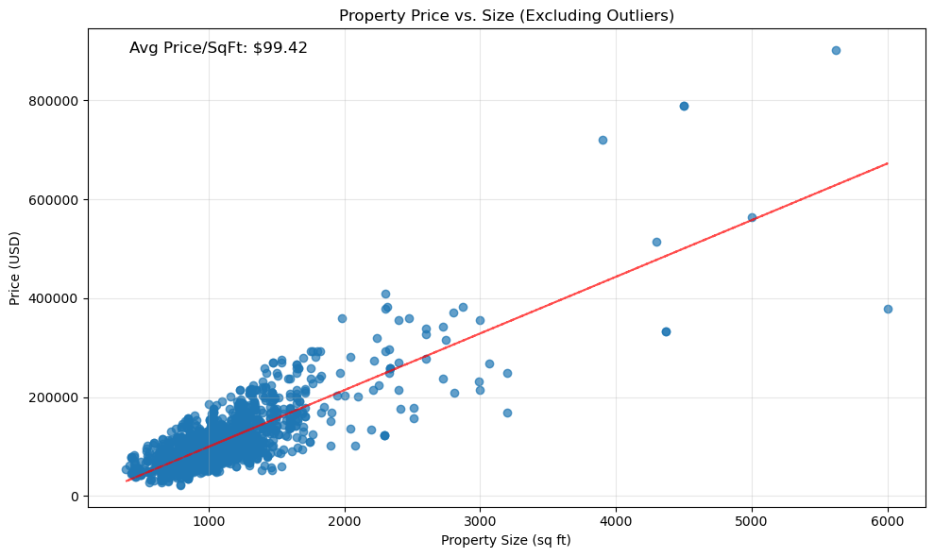
Exploratory Data Analysis
Price per sqft
Notes:
Carlisle price per sqft 168
Manhattan price per sqft 1500-1900

Slide 8
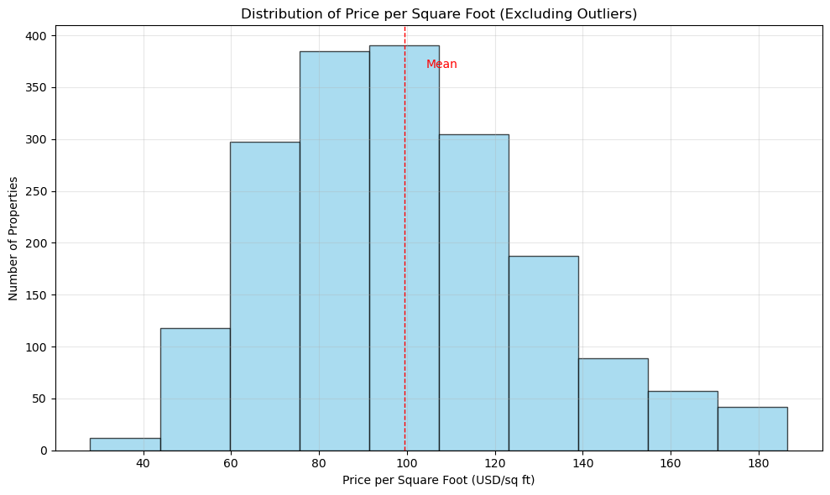
Exploratory Data Analysis
Distribution of price per sq ft excluding outliers
Notes:
Carlisle price per sqft 168
Manhattan price per sqft 1500-1900

Slide 9
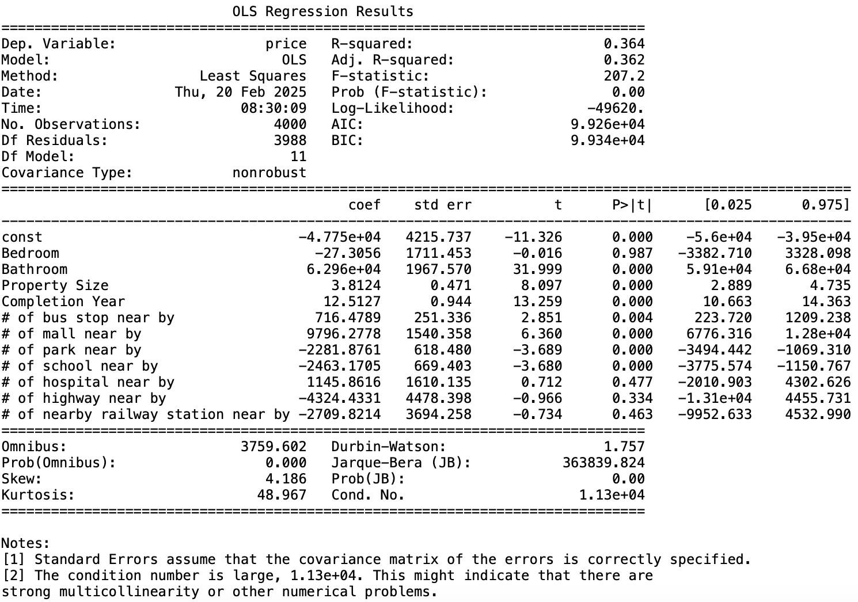
Exploratory Data Analysis
Notes:
Significant positive relationship
Bathroom
Property size
Completion year
# of bus stop near by
# of mall near by
Significant negative relationship
# of school near by
# of park near by

Slide 10
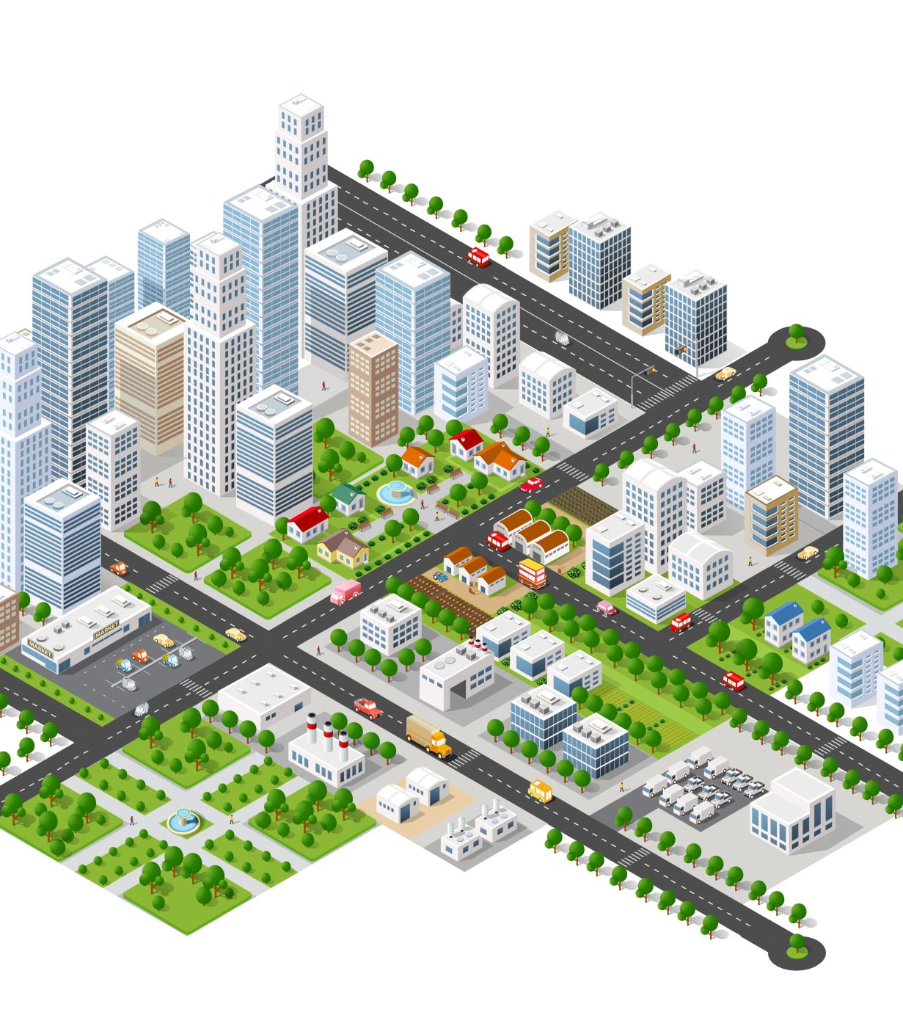
Implication for stakeholders
Condominum Developers
Shouldn’t develop near schools or parks for maximum price
Condominum Shoppers
Getting condos near schools or parks for discount
Should avoid near highways as it doesn’t offer a discount and negative air quality
Should avoid near malls if not a frequent shopper as it increases price significantly

Slide 11
Ethical, Legal, Societal implications
Ethical implications
What would happen if developers aren’t creating houses near schools?
Societal implications of longer commute time for students when sleep is crucial for them
Legal implications
Developers not building near schools or parks just to make a quick profit
How would they justify this against any of the activist groups?
Societal implications
If newer houses aren’t being built around schools and parks, would there be any investment towards schools and parks in the long term?

